Slide 1
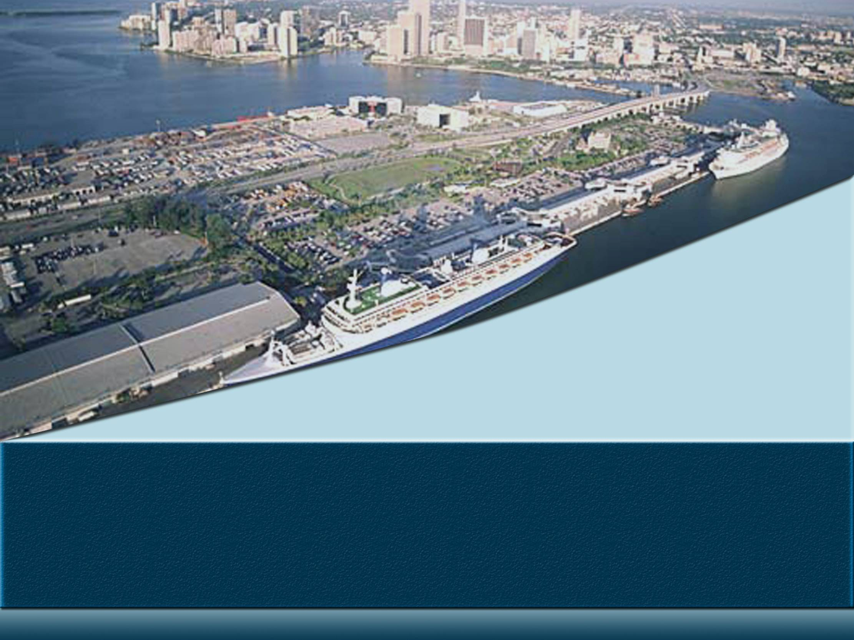
Transfield Services North America Transportation Infrastructure
Port of Miami Tunnel

Slide 2
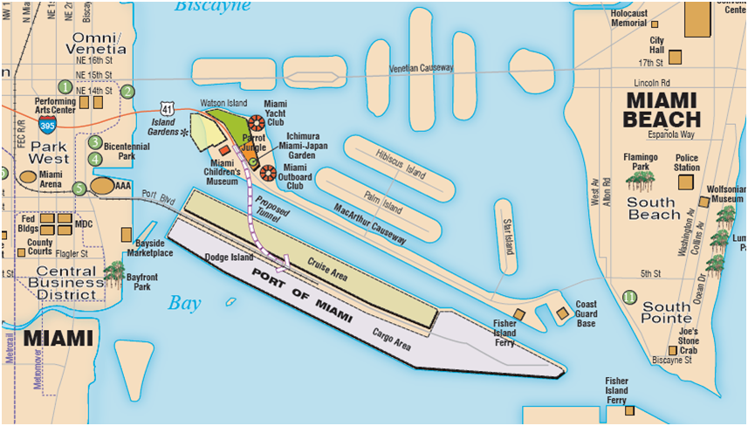
Port of Miami Tunnel Geography
Consists of an undersea tunnel link from Watson Island to the Port of Miami on Dodge Island

Slide 3
35 Year Design-Build-Finance-Operate-Maintain Project (DBFOM)
CONTRACT
  On October 15, 2009, the state of Florida and the MAT Concessionaire, LLC (the Miami Access Tunnel consortium) reached final agreement on the Port of Miami Tunnel project, which will be developed as a public-private partnership.
CONCESSIONAIRE
  MAT Concessionaire, LLC is held by Meridiam Infrastructure and Bouygues.
      Bouygues Civil Works Florida – Construction
      Jacobs Civil Inc, – Design Engineer
      Meridiam Infrastructure – Equity Partner
      Transfield Services – Operations and Maintenance
FINANCING
The project construction and development cost is financed as follows:
MAT Concessionaire Shareholders’ equity $80 million
Private commercial banks loan $342 million
Federal Transportation Infrastructure Finance and Innovation Act (TIFIA) loan from the U.S. Department of Transportation $341 million
Pre-determined construction payments from FDOT that are triggered by the achievement of certain construction milestones. $100 million

Slide 4
Financing
The project construction and development cost is financed as follows:
MAT Concessionaire Shareholders’ equity | $80 million
Private commercial banks loan | $342 million
Federal Transportation Infrastructure Finance and Innovation Act (TIFIA) loan from the U.S. Department of Transportation | $341 million
Pre-determined construction payments from FDOT that are triggered by the achievement of certain construction milestones. | $100 million

Slide 5
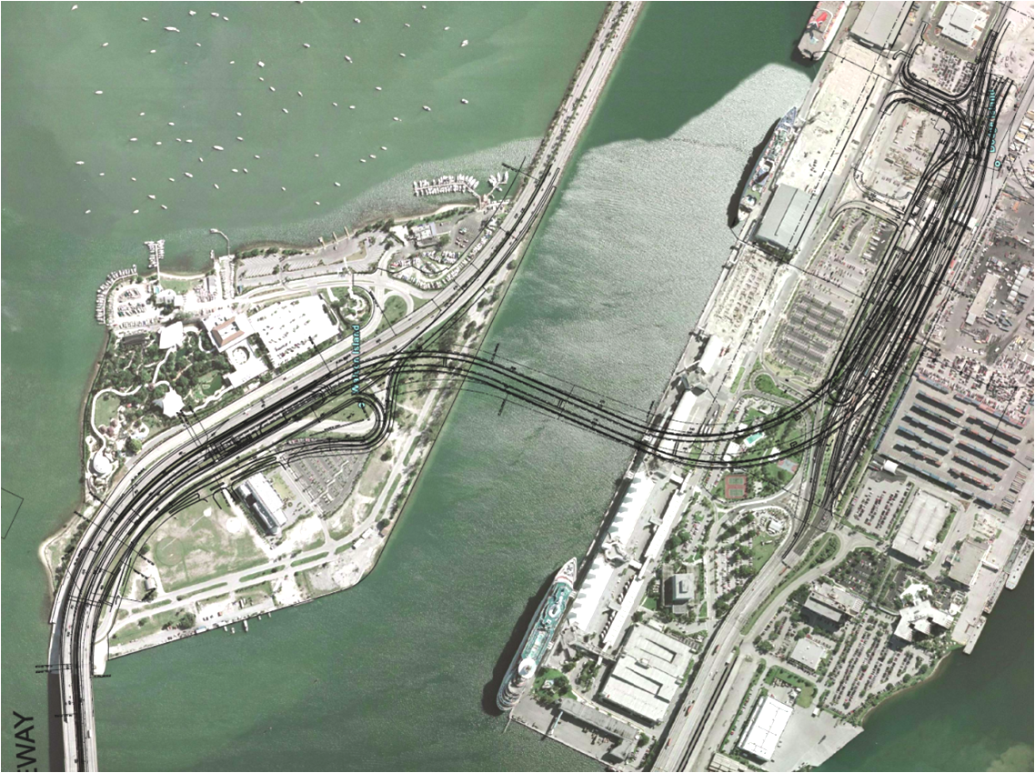
Tunnel Proposed Alignment
  The 3900ft twin tube tunnels will create a new connection under the main shipping channel to the city’s cruise and container port on Dodge Island

Slide 6
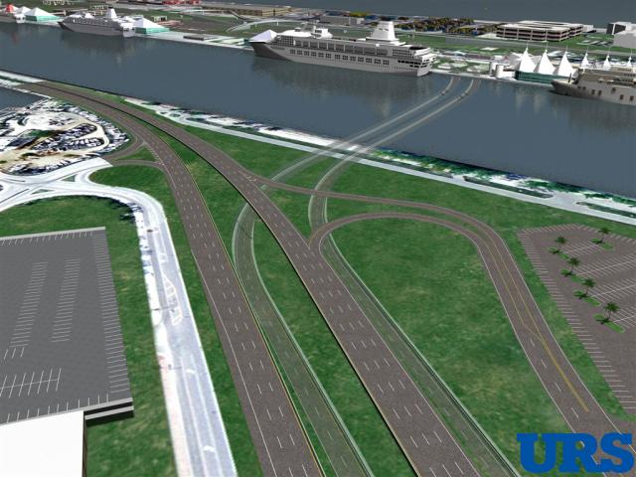
Underground Tube Alignment - Conceptual

Slide 7
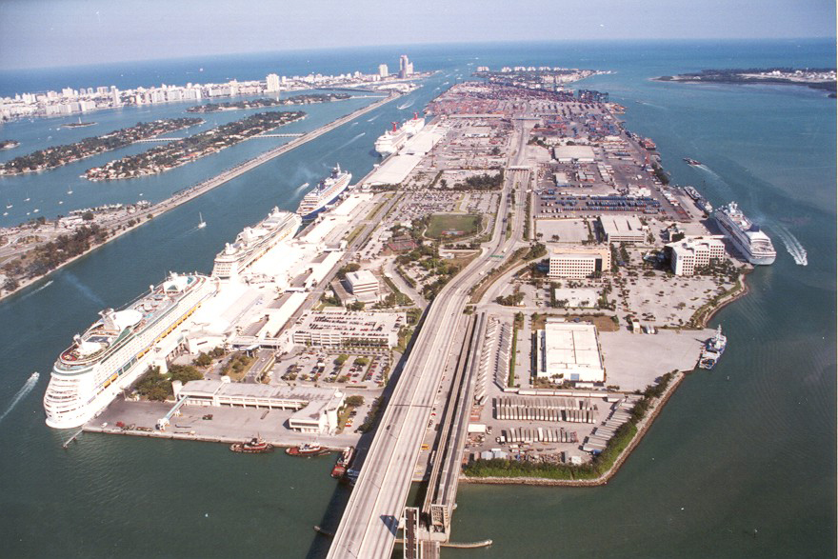
Construction
Construction activity on Watson Island began in late June 2010
Actual tunnel boring will begin on Watson Island in the Summer of 2011
Same number of lanes will be maintained on the MacArthur Causeway
Tunnel is expected to be open to the public 55 months after the contract signature
(June 2014)

Slide 8
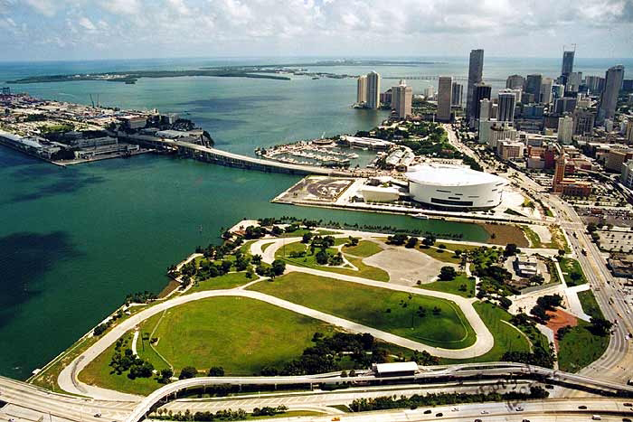
TSNA-TI Value Add (Early Involvement)
Operations and Maintenance Plan Development
Operational Design Reviews
  Design Durability Reviews (Structural)
  Maintainability Reviews (Mechanical & Electrical & Piping)
  Operations & Maintenance buildings layout design
  Development of Equipment System Nomenclature for Design
  Fire & Life Safety Committee

Slide 9
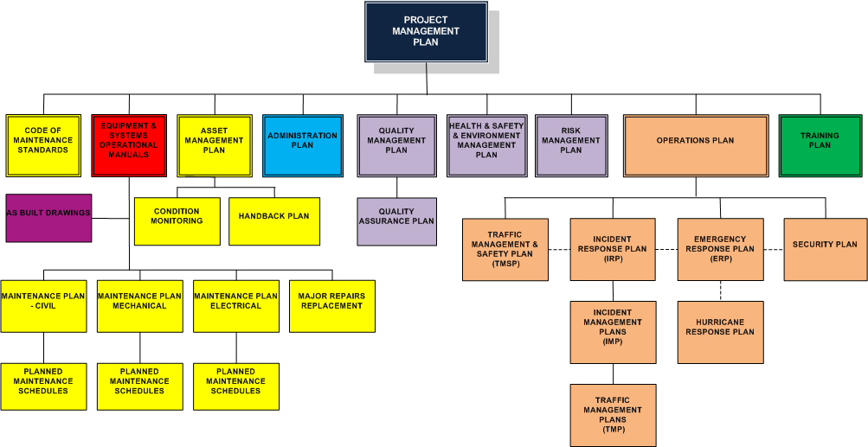
Project Management Plan
DRAFT

Slide 10
Operability & Maintainability Reviews
  The full benefit of O&M reviews is often not fully appreciated, this is a critical process for safety critical infrastructure such as tunnels;
  Provides the opportunity for the O&M provider to leverage their full capability and real life experience;
  Balances the short term and long term life cycle cost objectives between the various parties involved;
  Often there is no/little cost impact to incorporating operability or maintainability changes, rather design optimization if identified early;
  Often covers criteria that is not covered by regulations, codes or laws:
  The end user benefits from a safer more efficient asset.

