Slide 1
STRUCTURES ASSET MAINTENANCE CONTRACT EXPERIENCES IN FLORIDA
AMOTIA 2nd ANNUAL CONFERENCE
Nashville, TN
A Former Florida DOT Employee’s Experience in Districts 1 and 7
Jose (Pepe) Garcia, P.E.
Manager, Bridge Preservation and Management
PB Americas Complex Bridges TEC
September 22-24, 2010

Slide 2
What will be Presented
  Background
  Scope of Work
  Award of Contracts
  Outcome
  Lessons Learned
  Perspectives
  Acknowledgement and Q&A

Slide 3
Background
West central and Southwest Florida
  4 contracts
  17 counties
  Included toll facilities
Owner Representative
  FDOT District 1 and 7 Structures Maintenance Office
    Maintenance
    Repair and Rehabilitation Construction Residency
District 7 Contracts
Skyway Corridor Contract
District 1 North Contracts
District 1 South Contracts

Slide 4
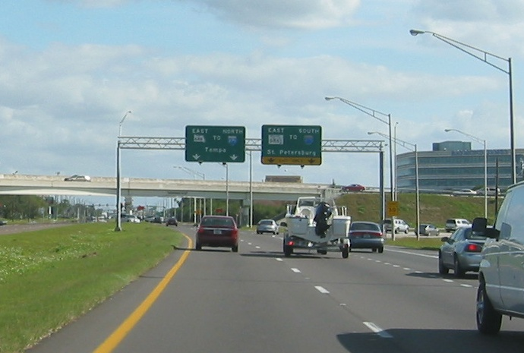
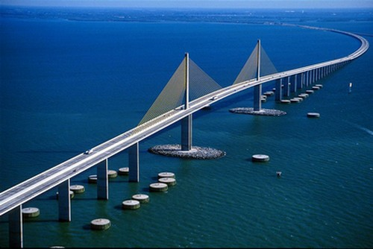
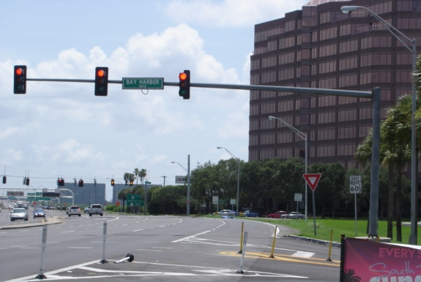
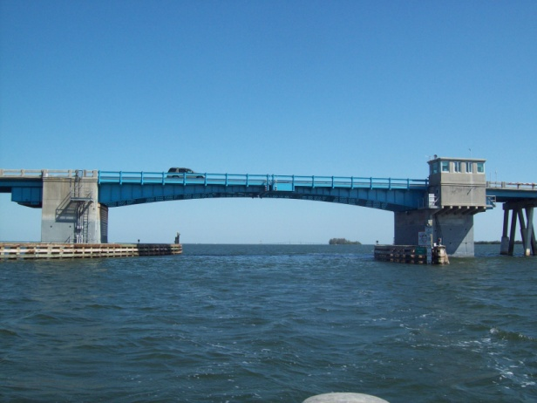
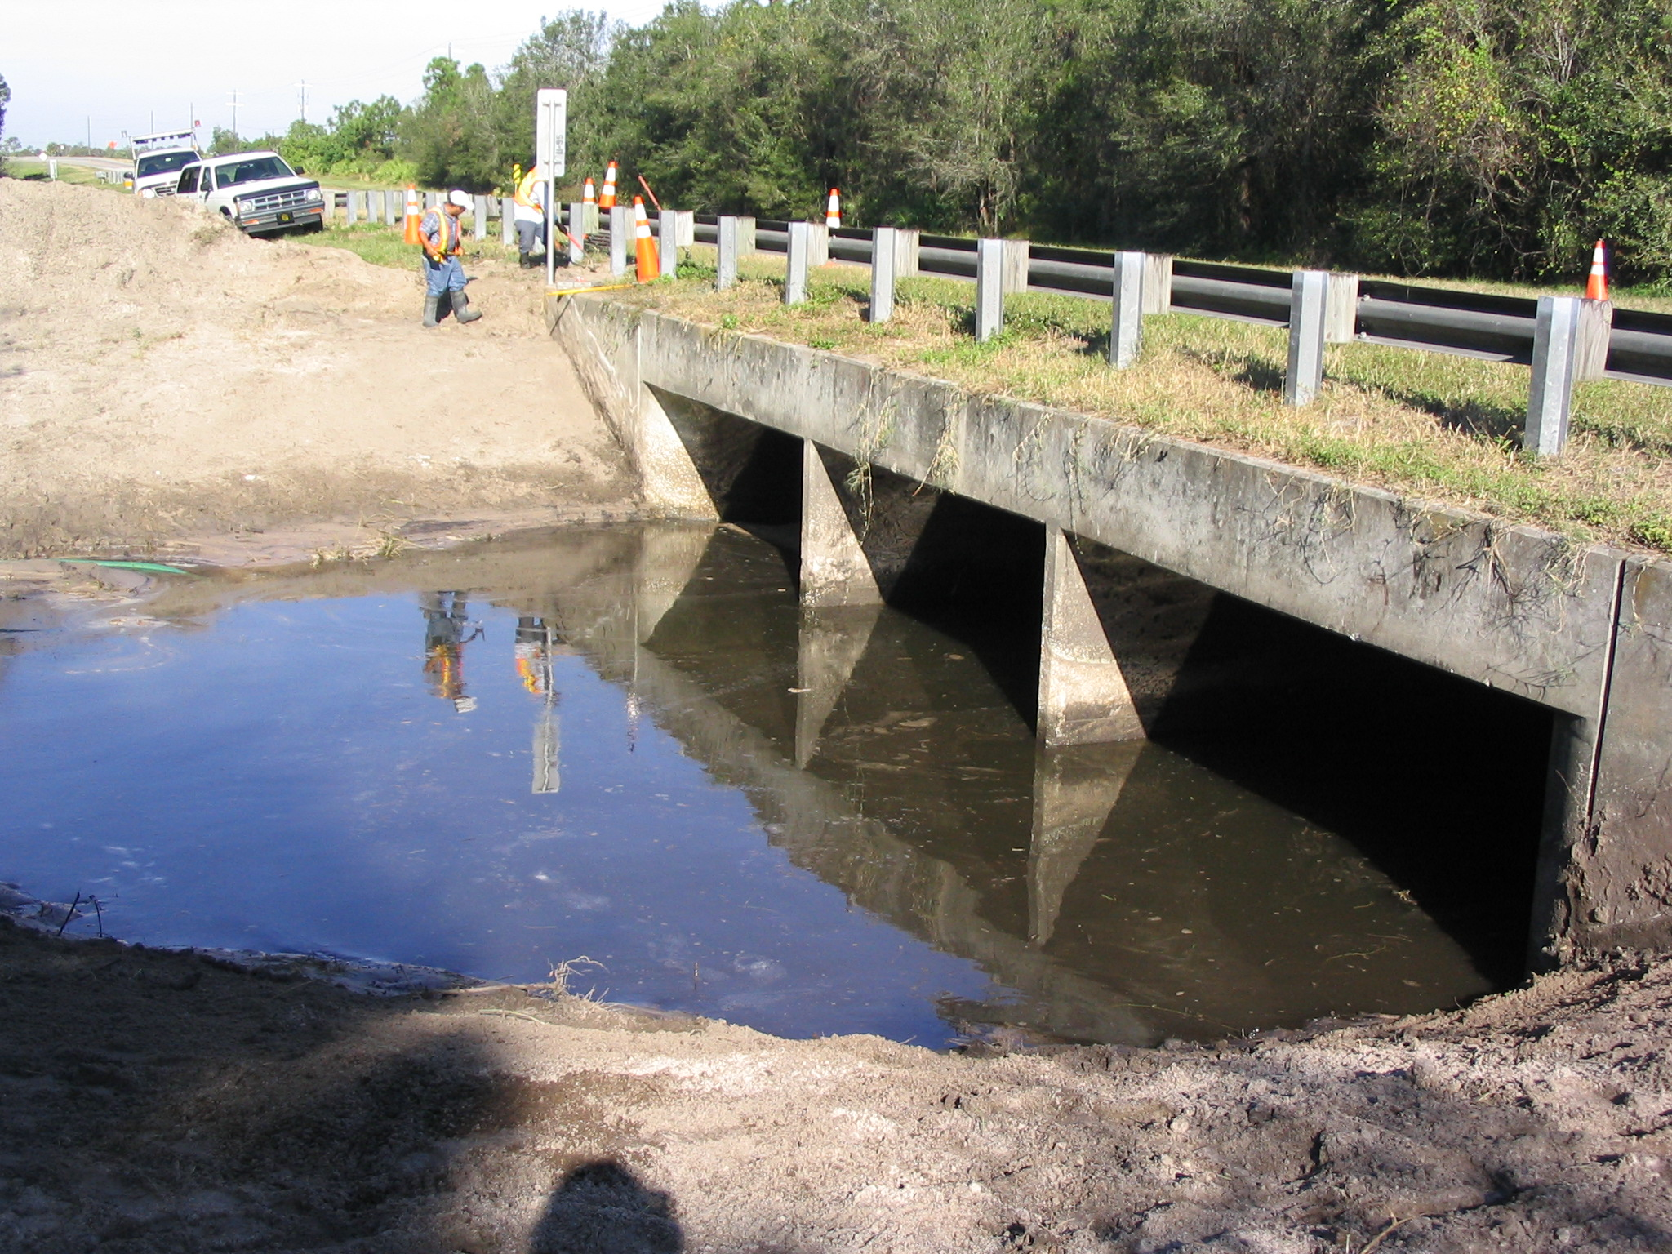
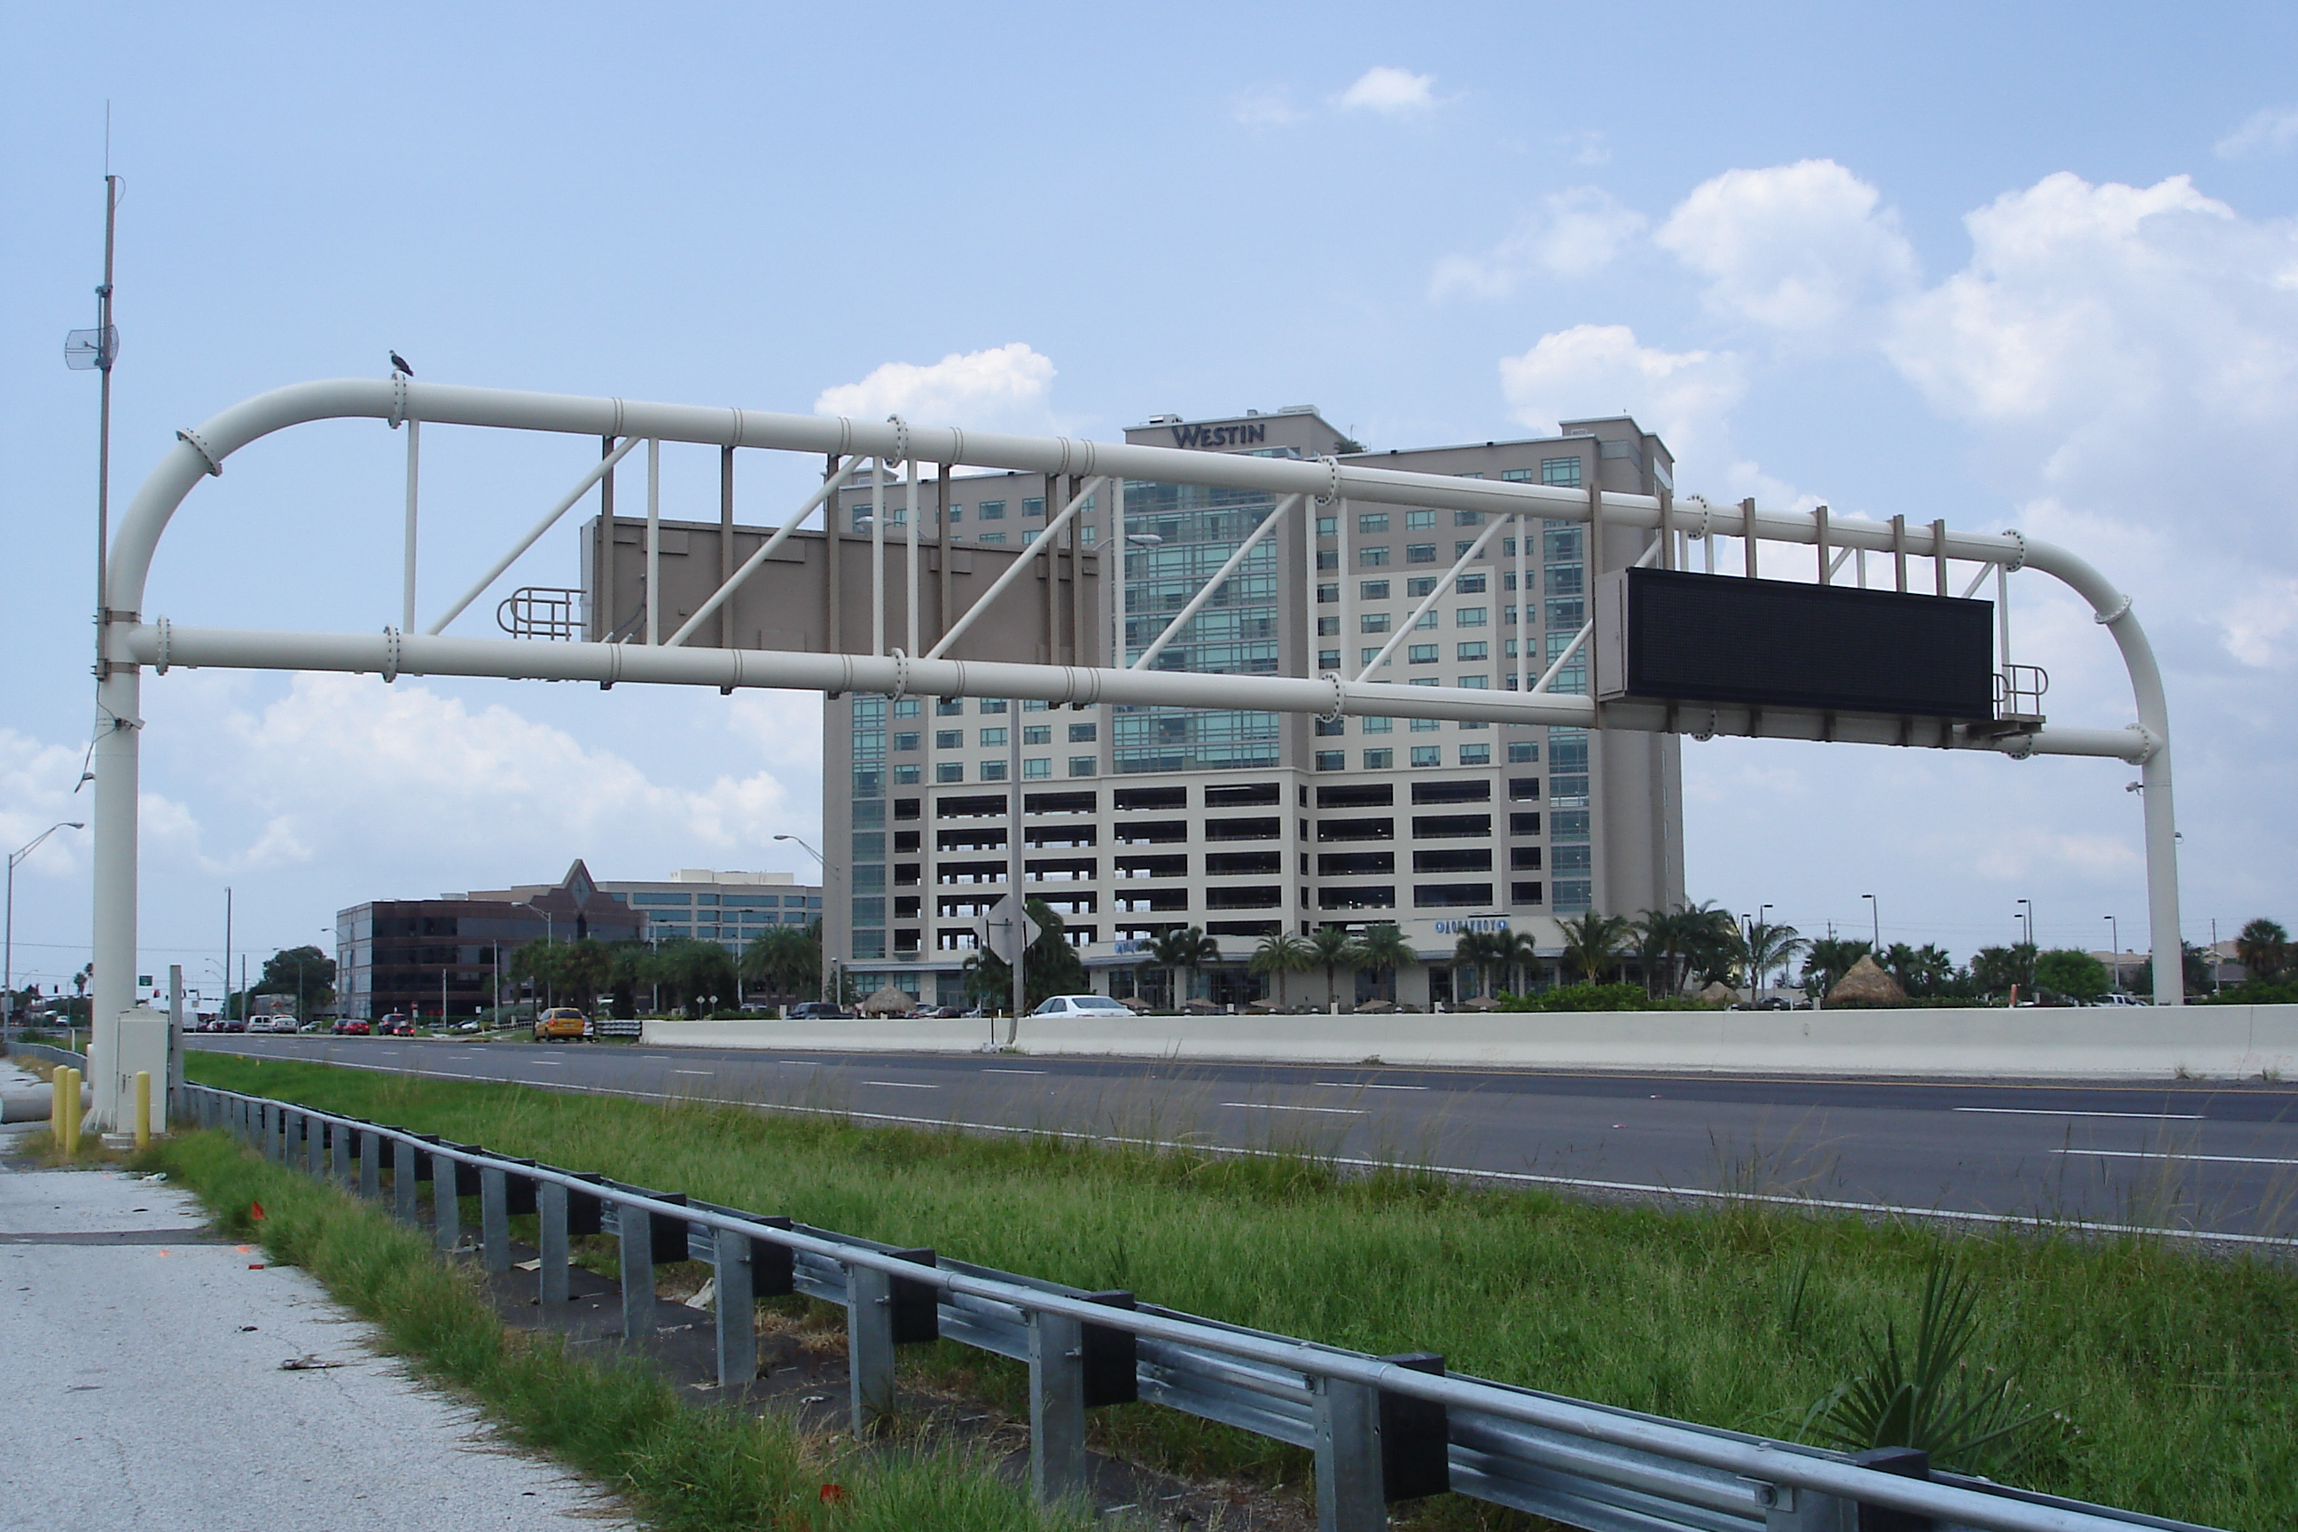
Background
Bob Graham Skyway Bridge
Over 3400 NBI bridge qualifiers (28% Florida)
  Bob Graham Sunshine Skyway Bridge
  Complex and simple structures
Over 2300 overhead sign structures, HMLP, ITS and traffic mast arm locations
Over hundreds of miles of travel

Slide 5
Background
Why AMC in 2002?
Backlog of bridge work from previous inspections
Reaction to large inventory
Increasing administration costs
Difficulty in staffing required expertise
Central office direction: Do more with less
Qualified contractors and subs in the state
Multi-expertise/year contracts with renewal
Emergency responses
RFP concept

Slide 6
Scope of Work
Basic Definitions
Generic for Performance Based Contract
Specific Requirements
Key Performance Measures

Slide 7
Scope of Work (cont’d)
Key performance measures for bridges
Florida Statutes: 334.046 F.S.
Florida DOT 50-Year Plan
Florida DOT QAR Multi-tier Requirements

Slide 8
Award of Contracts
Technical Proposal Review
Cost Proposal Review
Proposal is Part of Scope

Slide 9
Outcome: Was it a success?
Scope and performance measures adequately identified and met or exceeded
Partnering approach was established
Necessary interaction increased confidence
Excellent emergency/incident response
Minimum negative bonus and no claims
State saved money/known budget
Contractor made money

Slide 10
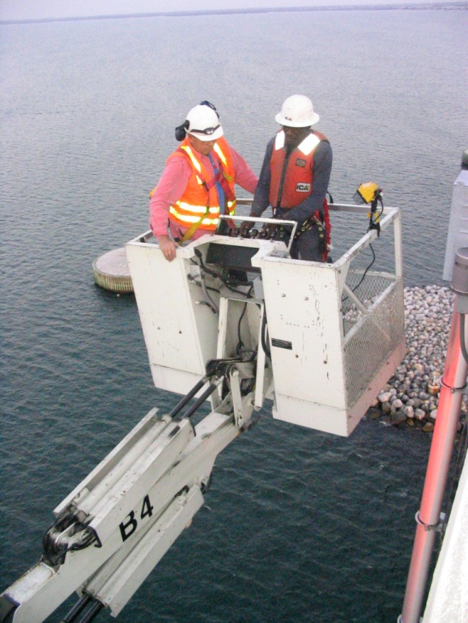
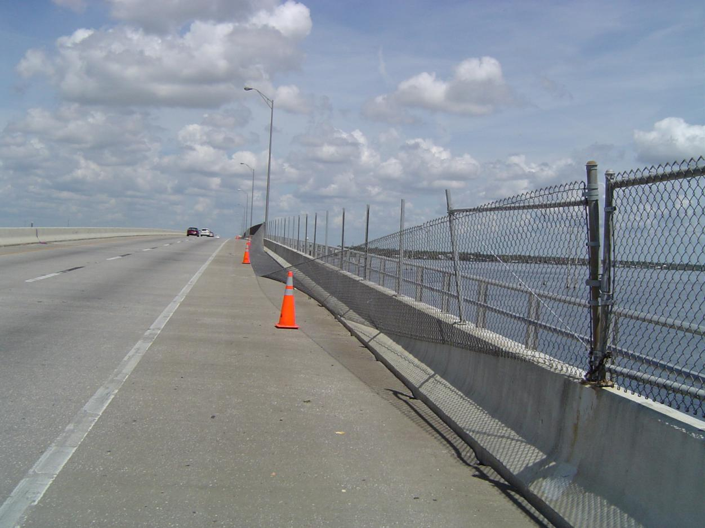
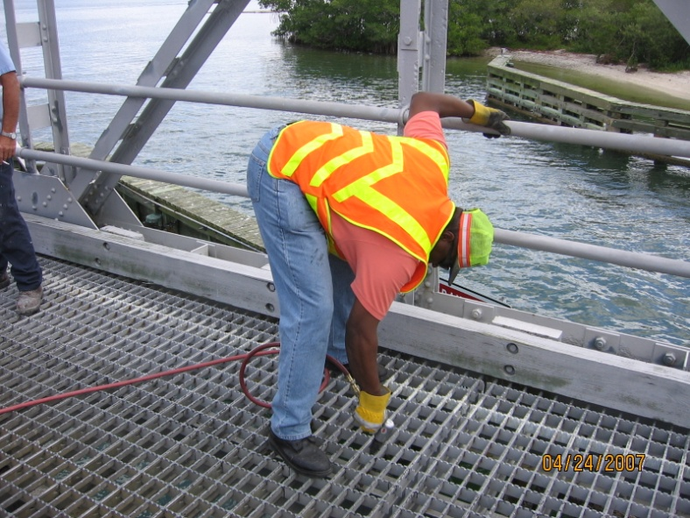
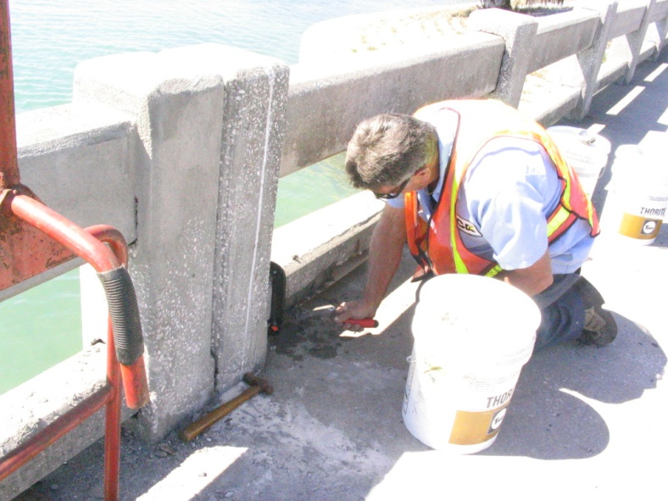
Maintenance Activities

Slide 11
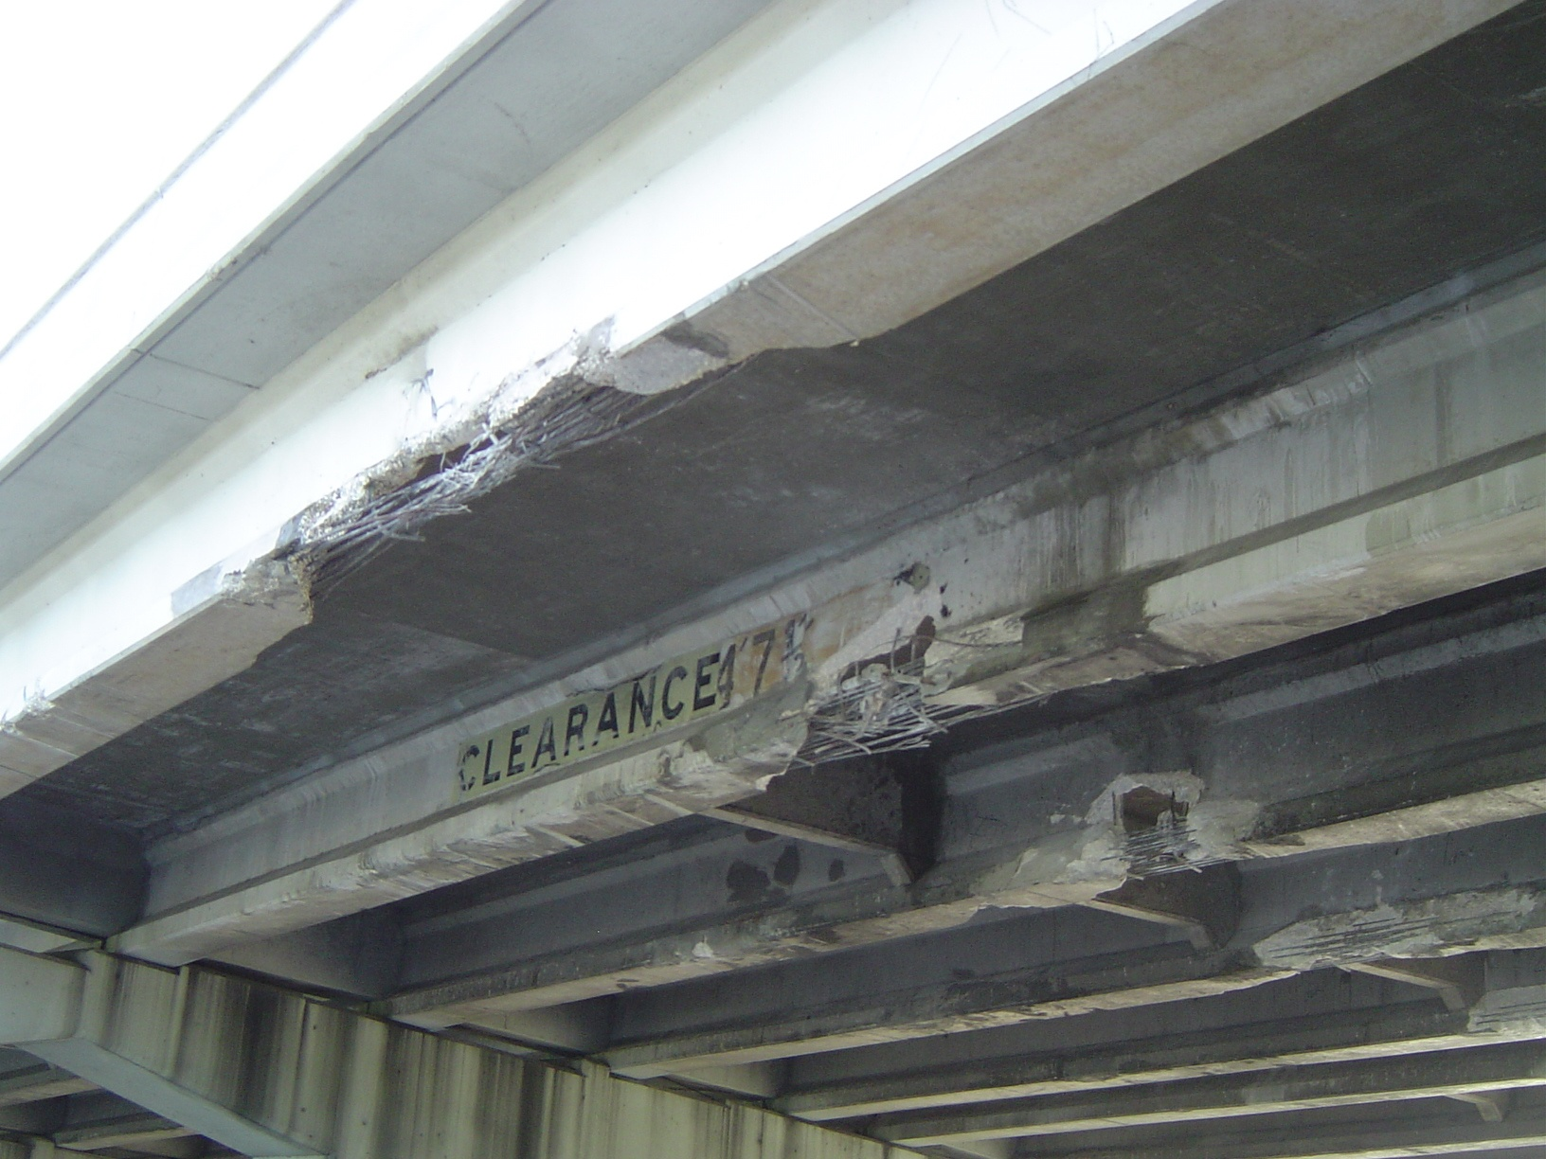
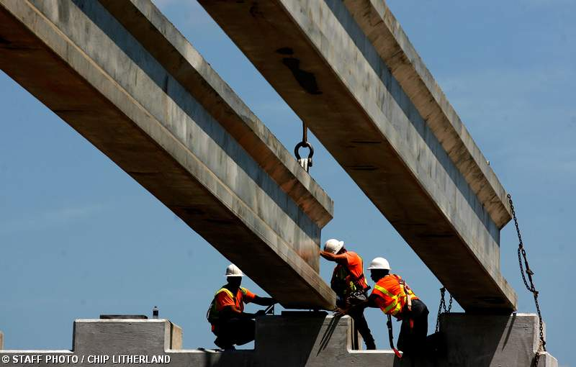
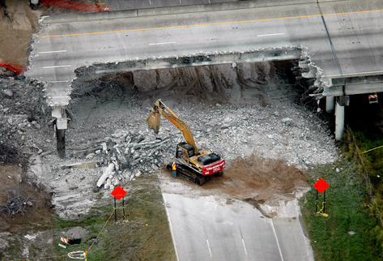
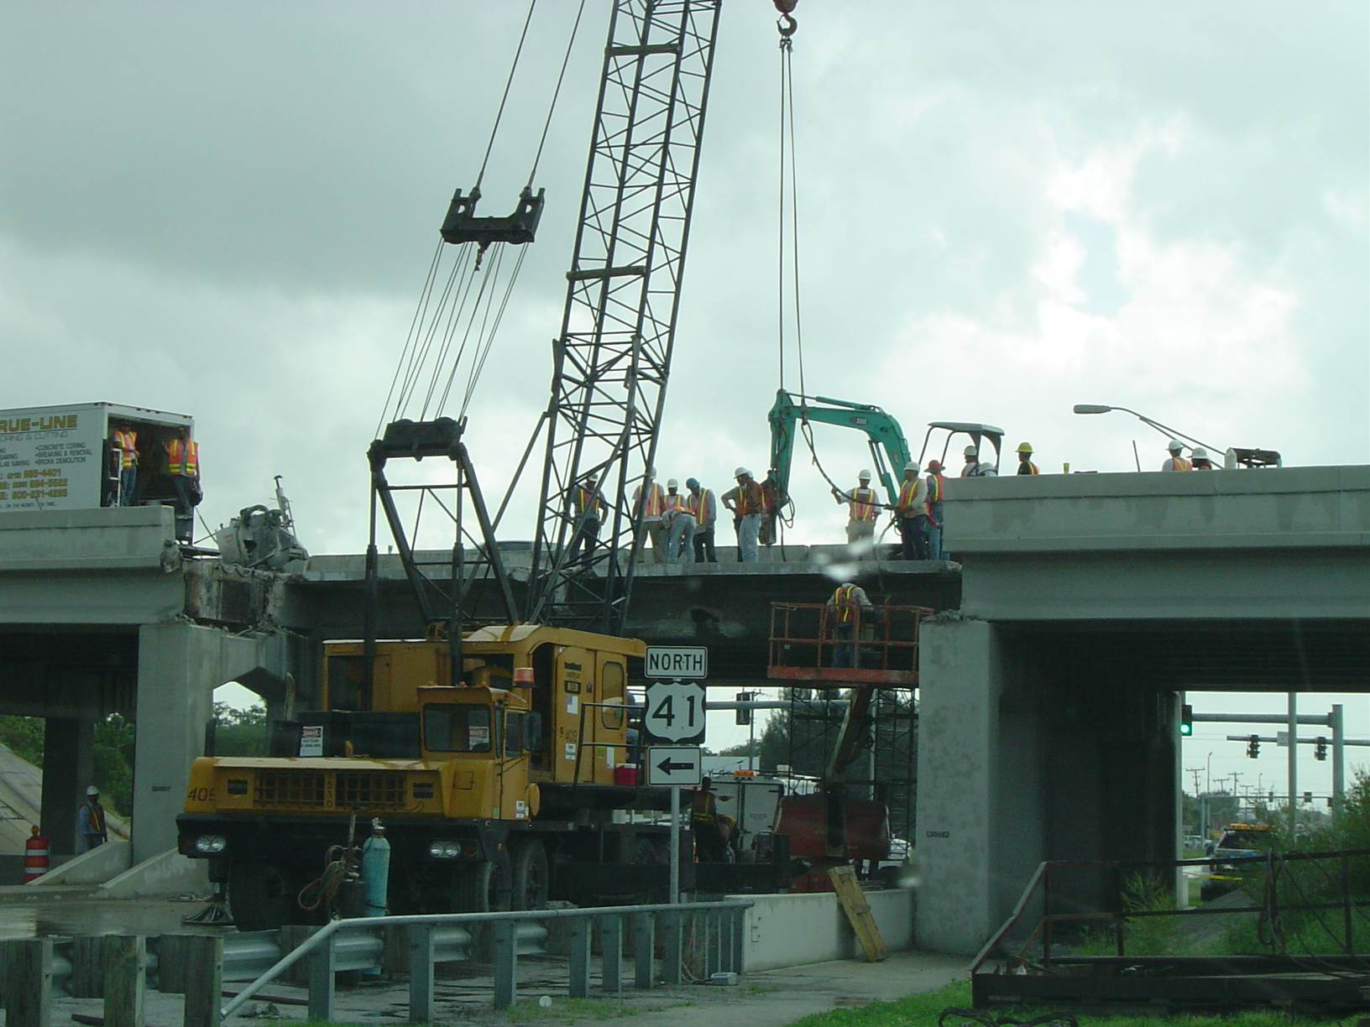
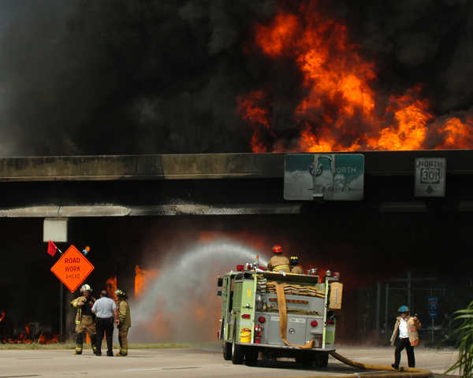
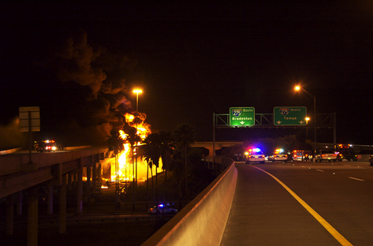
Emergency Responses

Slide 12
Lessons Learned
Owners and Industry
Develop adequate scope
Technical support needs and responsibilities
Partnering meetings with agency (including legal) and industry groups during scope development
Implement effective and flexible QA/QC program
Ensure project managers and staff understand concept and scope

Slide 13
Lessons Learned (cont’d)
Owners and Industry
Identify project as a partnering project
Share award justification with staff
Push-button feature within contract was effective
Work order/other meetings nurtured partnership
Multi-year/renewal clauses promote good
Inform senior management
People, not computers, make it happen

Slide 14
Perspectives
Public and Government Perspectives: Do more with less
FHWA push for Preservation and Management

Slide 15
My Perspectives
Why should government agencies consider structures asset maintenance contracts?
  Tool in the bag
  Reallocation of resources
  Cost effective
  Multi-disciplinary/activity
  Technical needs
  Instigate preservation
  Absorb additional responsibilities
  Scope can address apprehensions
  Work with known budgets
  Concept works…even after July 29th, 2010…

Slide 16
PB Perspective
New Bridge Preservation and Management Group
PB’s Extensive Experience in Design, Repair and Rehabilitation
PB’s Research Participation
Available to AMC and Government

Slide 17
QUESTIONS? garciaj1@pbworld.co
(813) 207-2974
(813) 442-3452
Thank you.

